Slide 1

S.E.A COLLEGE OF ENGINEERING & TECHNOLOGY
EKTANagar,NearAyyappa Nagar Circle,Devasanda Main Road,K.R.Puram,Bangalore-49
Affliatedto VTU,BelgaviandApproved by AICTE,New Delhi and AccreditatedB++ NAAC
Department of Electronicsand Communication Engineering
IoT Based Sun Tracking, Solar Panel Monitoring & Solar Power Management System
PRESENTED BY
(1SP22EC005) (1SP22EC013) (1SP22EC026) (1SP22EC057)
ANJALI M
D N CHANDANA
NOTI HARSHAVARDHAN
TEJA S
UNDER THE GUIDANCE OF
Mrs . ASHA V K R
Asst. Professor Dept. of ECE
Department of ECE
S.E.A COLLEGE OF ENGINEERING & TECHNOLOGY

Slide 2

CONTENT
Problem Statement
Introduction
Literature Survey
Methodology
Observation & Result

Slide 3
PROBLEM STATEMENT
Conventional solar panels are fixed in one position, resulting in a significant loss of potential energy due to the varying angle of sunlight throughout the day. Additionally, users lack the means to monitor system performance in real-time or detect faults without manual inspection. This leads to inefficiencies, higher maintenance costs, and underutilization of available solar resources. A smarter system is needed that can adapt to sunlight direction, monitor output remotely, and manage power usage intelligently.

Slide 4
INTRODUCTION
Solar energy is one of the most abundant renewable energy sources available on Earth. However, most traditional solar panels are static and do not follow the movement of the sun, leading to sub-optimal energy production. With the advancement of the Internet of Things (IoT), we can enhance solar panel systems to be smarter, more efficient, and manageable remotely. This project presents an IoT-based system that combines sun tracking and power management for better solar energy utilization.

Slide 5
LITERATURE REVIEW
Title | Authors | Publications | About
IoT Based Solar Panel Tracking System with Weather Monitoring System. | K.Dinesh , Lakshmi Priya.A , Sandhya. M | Recent Trends in Intensive Computing M.Rajeshet al.(Eds.) © 2021 The authors and IOS Press. | This Created framework can be executed in several solar plant stations to measure the precise strength created from the ones devices
Enhancing Energy Efficiency through IoT- enabled solar tracking. | Kaushalya thopate, Mayuri gawade,Surabhi kakade,Suvarna bahir. | 2024 IEEE International conference on the interdisciplinary in Technology and Management for social innovation (IATMSI) | To develop a solar energy tracking panel that can rotate for enhanced power generation.
Solar Tree based Home appliance Monitoring system using IoT. | M.Ishwarya Niranjana, J Dhanasekar, S.Karan, N.Nithesh Kumar. | 2023 7th International conference on Electronics, communication & Aerospace Technology(ICECA) | To improve the efficiency of solar energy utilization by employing solar panels.

Slide 6
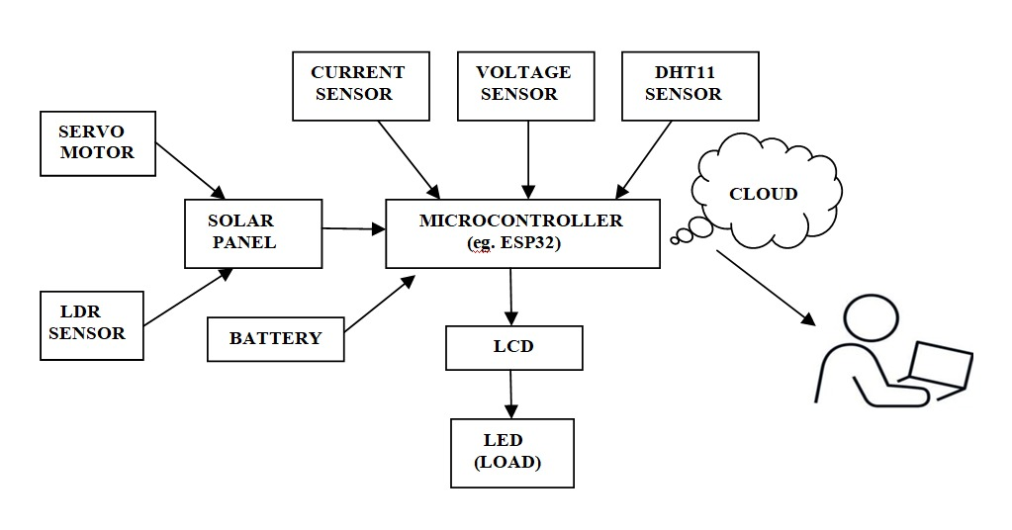
METHODOLOGY
CIRCUIT DIAGRAM:

Slide 7
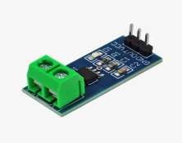
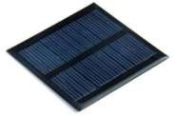
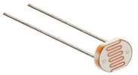
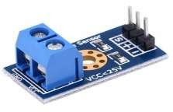
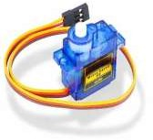
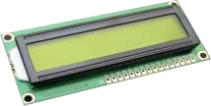
METHODOLOGY
HARDWARE COMPONENTS:
Solar Panel
Microcontroller
LDR Sensor
Current Sensor
Voltage Sensor
LCD
Servo Motor
DHT 11
LED

Slide 8
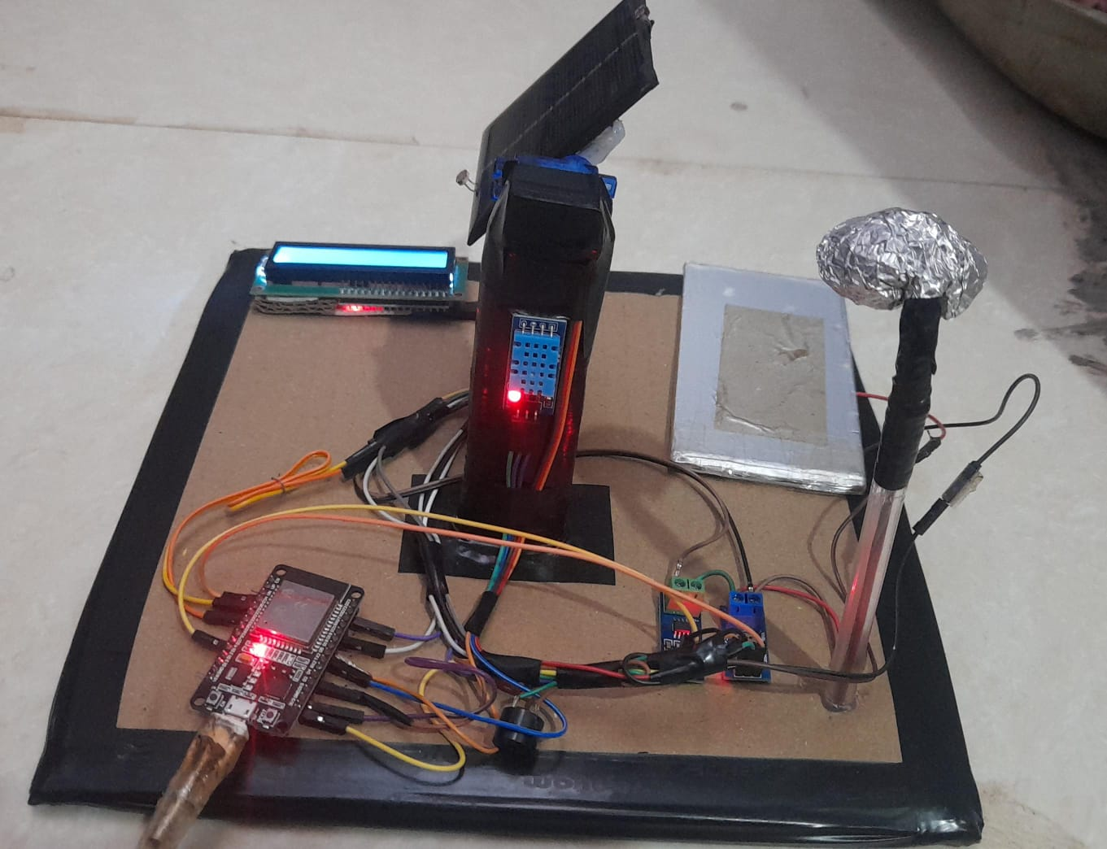
OBSERVATION & RESULT

Slide 9
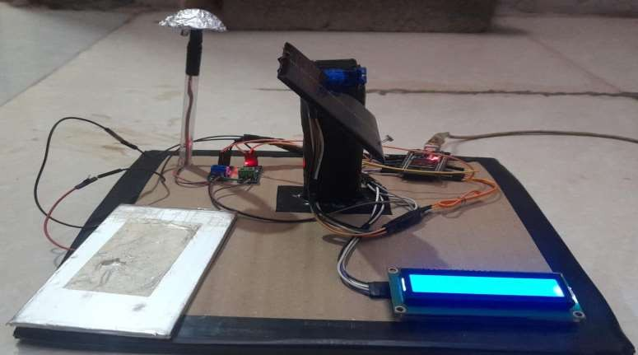
OBSERVATION & RESULT

Slide 10
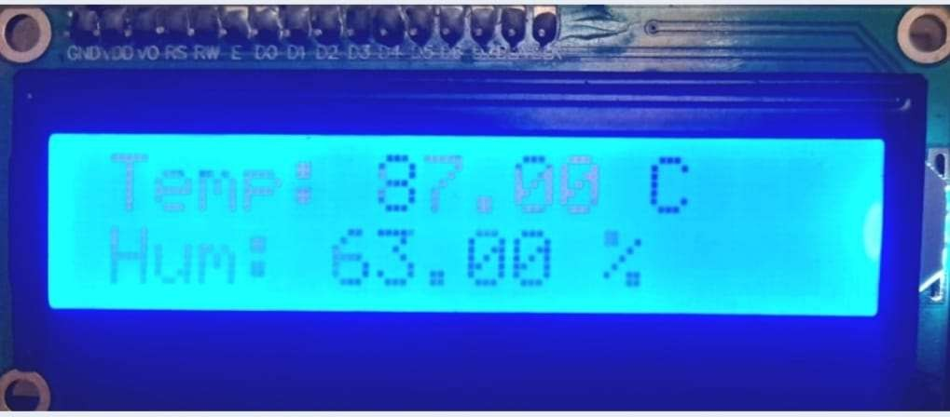
OBSERVATION & RESULT

Slide 11
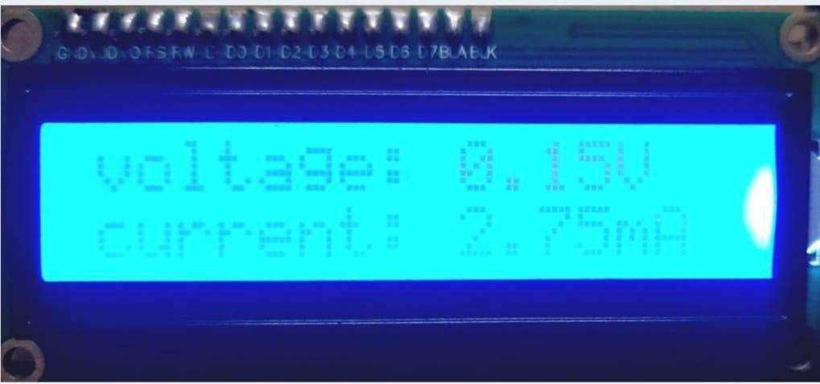
OBSERVATION & RESULT

Slide 12
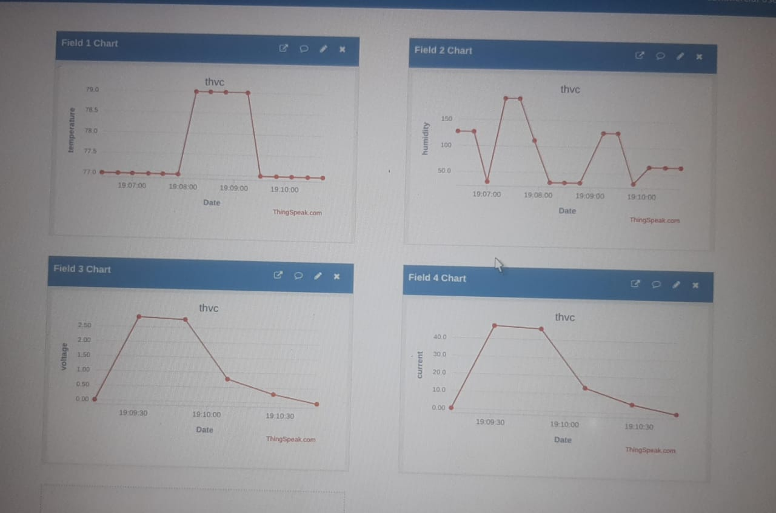
OBSERVATION & RESULT

Slide 13

THANK YOU

